Slide 1
Operating Systems
Real-Time Operating Systems
Chalermek Intanagonwiwat
Slides courtesy of Subhashis Banerjee

Slide 2
Real-Time Systems
Result in severe consequences if logical and timing correctness are not met
Two types exist
  Soft real-time
    Tasks are performed as fast as possible
    Late completion of jobs is undesirable but not fatal.
    System performance degrades as more & more jobs miss deadlines
    Example:
      Online Databases

Slide 3
Real-Time Systems (cont.)
  Hard real-time
    Tasks have to be performed on time
    Failure to meet deadlines is fatal
    Example :
      Flight Control System
  Qualitative Definition

Slide 4
Hard and Soft Real Time Systems
(Operational Definition)
Hard Real Time System
  Validation by provably correct procedures or extensive simulation that the system always meets the timings constraints
Soft Real Time System
  Demonstration of jobs meeting some statistical constraints suffices.
Example – Multimedia System
  25 frames per second on an average

Slide 5
Most Real-Time Systems are embedded
An embedded system is a computer built into a system but not seen by users as being a computer
Examples
  FAX machines
  Copiers
  Printers
  Scanners
  Routers
  Robots

Slide 6
Role of an OS in Real Time Systems
Standalone Applications
  Often no OS involved
  Micro controller based Embedded Systems
Some Real Time Applications are huge & complex
  Multiple threads
  Complicated Synchronization Requirements
  File system / Network / Windowing support
  OS primitives reduce the software design time

Slide 7
Features of Real Time OS (RTOS)
Scheduling.
Resource Allocation.
Interrupt Handling.
Other issues like kernel size.

Slide 8
Foreground/Background Systems
Small systems of low complexity
These systems are also called “super-loops”
An application consists of an infinite loop of desired operations (background)
Interrupt service routines (ISRs) handle asynchronous events (foreground)

Slide 9
Foreground/Background Systems (cont.)
Critical operations must be performed by the ISRs to ensure the timing correctness
Thus, ISRs tend to take longer than they should
Task-Level Response
  Information for a background module is not processed until the module gets its turn

Slide 10
Foreground/Background Systems (cont.)
The execution time of typical code is not constant
If a code is modified, the timing of the loop is affected
Most high-volume microcontroller-based applications are F/B systems
  Microwave ovens
  Telephones
  Toys

Slide 11
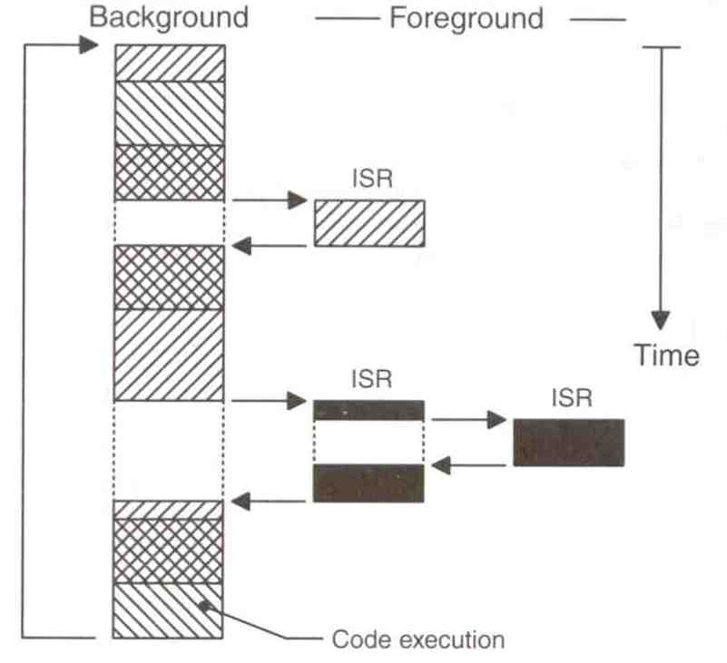
Foreground/Background Systems (cont.)
From a power consumption point of view, it might be better to halt and perform all processing in ISRs

Slide 12
Multitasking Systems
Like F/B systems with multiple backgrounds
Allow programmers to manage complexity inherent in real-time applications

Slide 13
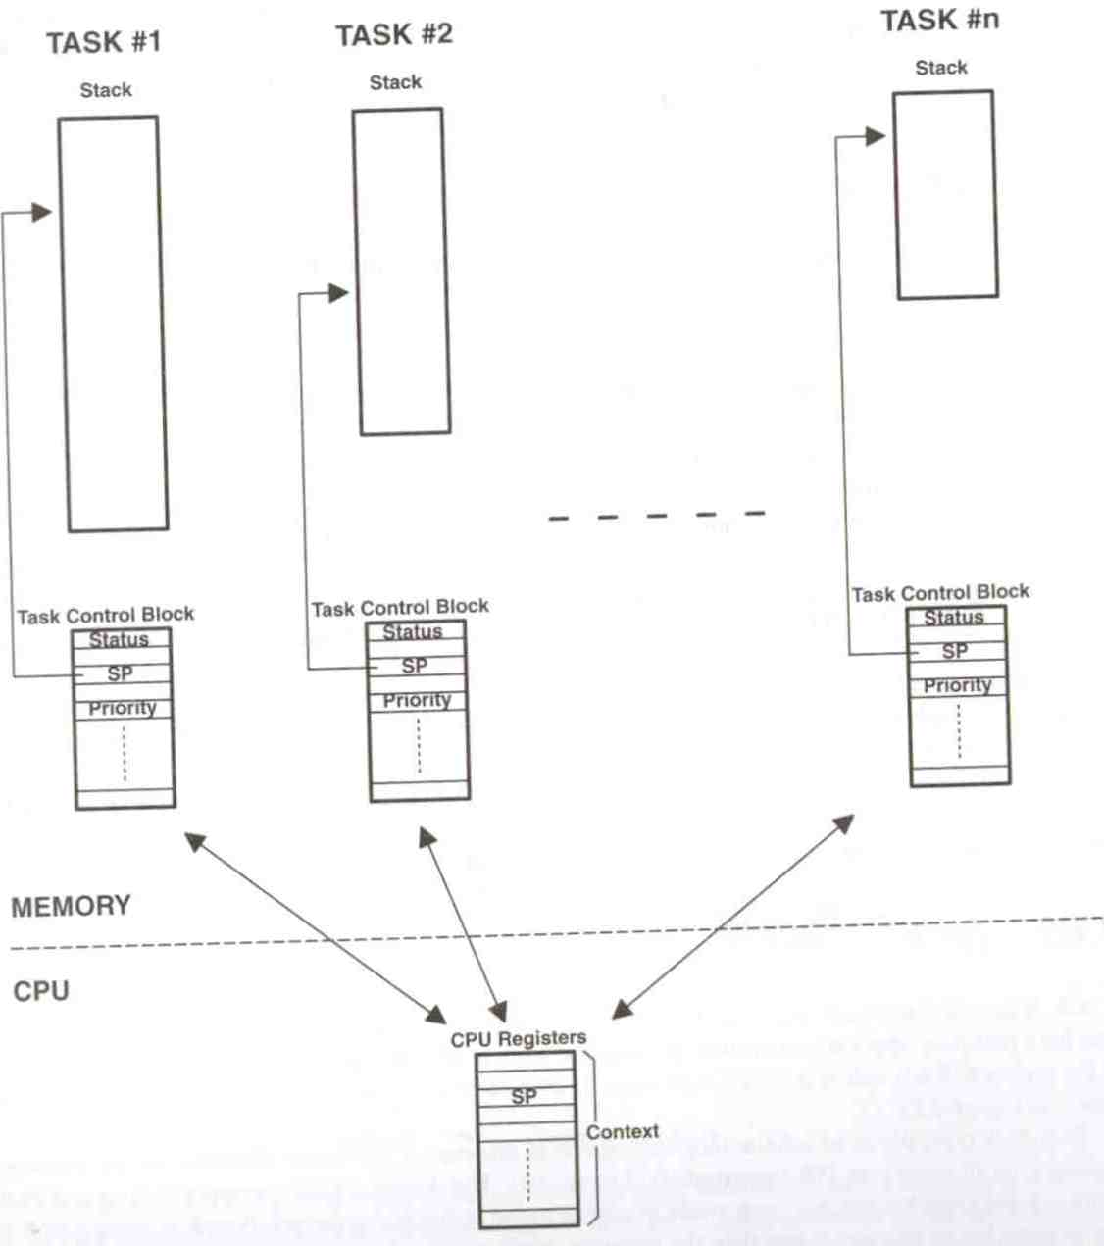
Multitasking Systems (cont.)

Slide 14
Scheduling in RTOS
More information about the tasks are known
  Number of tasks
  Resource Requirements
  Execution time
  Deadlines
Being a more deterministic system better scheduling algorithms can be devised.

Slide 15
Scheduling Algorithms in RTOS
Clock Driven Scheduling
Weighted Round Robin Scheduling
Priority Scheduling

Slide 16
Scheduling Algorithms in RTOS (cont.)
Clock Driven
  All parameters about jobs (execution time/deadline) known in advance.
  Schedule can be computed offline or at some regular time instances.
  Minimal runtime overhead.
  Not suitable for many applications.

Slide 17
Scheduling Algorithms in RTOS (cont.)
Weighted Round Robin
  Jobs scheduled in FIFO manner
  Time quantum given to jobs is proportional to it’s weight
  Example use : High speed switching network
    QOS guarantee.
  Not suitable for precedence constrained jobs.
    Job A can run only after Job B. No point in giving time quantum to Job B before Job A.

Slide 18
Scheduling Algorithms in RTOS (cont.)
Priority Scheduling
  Processor never left idle when there are ready tasks
  Processor allocated to processes according to priorities
  Priorities
    Static - at design time
    Dynamic - at runtime

Slide 19
Priority Scheduling
Earliest Deadline First (EDF)
  Process with earliest deadline given highest priority
Least Slack Time First (LSF)
  slack = relative deadline – execution left
Rate Monotonic Scheduling (RMS)
  For periodic tasks
  Tasks priority inversely proportional to it’s period

Slide 20
Schedulers
Also called “dispatchers”
Schedulers are parts of the kernel responsible for determining which task runs next
Most real-time kernels use priority-based scheduling
  Each task is assigned a priority based on its importance
  The priority is application-specific

Slide 21
Priority-Based Kernels
There are two types
  Non-preemptive
  Preemptive

Slide 22
Non-Preemptive Kernels
Perform “cooperative multitasking”
  Each task must explicitly give up control of the CPU
  This must be done frequently to maintain the illusion of concurrency
Asynchronous events are still handled by ISRs
  ISRs can make a higher-priority task ready to run
  But ISRs always return to the interrupted tasks

Slide 23
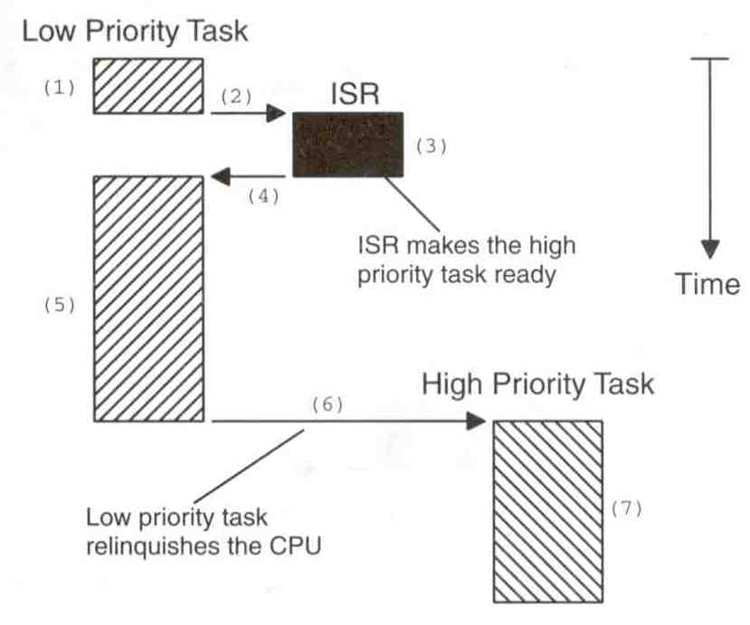
Non-Preemptive Kernels (cont.)

Slide 24
Advantages of Non-Preemptive Kernels
Interrupt latency is typically low
Can use non-reentrant functions without fear of corruption by another task
  Because each task can run to completion before it relinquishes the CPU
  However, non-reentrant functions should not be allowed to give up control of the CPU
Task-response is now given by the time of the longest task
  much lower than with F/B systems

Slide 25
Advantages of Non-Preemptive Kernels (cont.)
Less need to guard shared data through the use of semaphores
  However, this rule is not absolute
  Shared I/O devices can still require the use of mutual exclusion semaphores
  A task might still need exclusive access to a printer

Slide 26
Disadvantages of Non-Preemptive Kernels
Responsiveness
  A higher priority task might have to wait for a long time
  Response time is nondeterministic
Very few commercial kernels are non-preemptive

Slide 27
Preemptive Kernels
The highest-priority task ready to run is always given control of the CPU
  If an ISR makes a higher-priority task ready, the higher-priority task is resumed (instead of the interrupted task)
Most commercial real-time kernels are preemptive

Slide 28
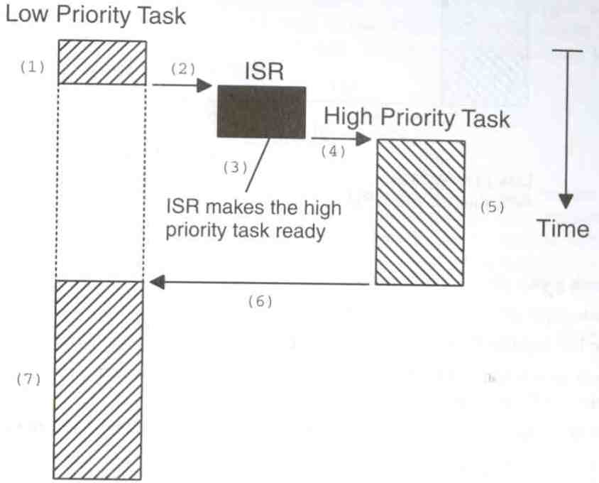
Preemptive Kernels (cont.)

Slide 29
Advantages of Preemptive Kernels
Execution of the highest-priority task is deterministic
Task-level response time is minimized

Slide 30
Disadvantages of Preemptive Kernels
Should not use non-reentrant functions unless exclusive access to these functions is ensured

Slide 31
Reentrant Functions
A reentrant function can be used by more than one task without fear of data corruption
It can be interrupted and resumed at any time without loss of data
It uses local variables (CPU registers or variables on the stack)
Protect data when global variables are used

Slide 32
Reentrant Function Example
void strcpy(char *dest, char *src)
{
while (*dest++ = *src++) {
…
}
*dest = NULL;
}

Slide 33
Non-Reentrant Function Example
int Temp;
void swap(int *x, int *y)
{
Temp = *x;
*x = *y;
*y = Temp;
}

Slide 34
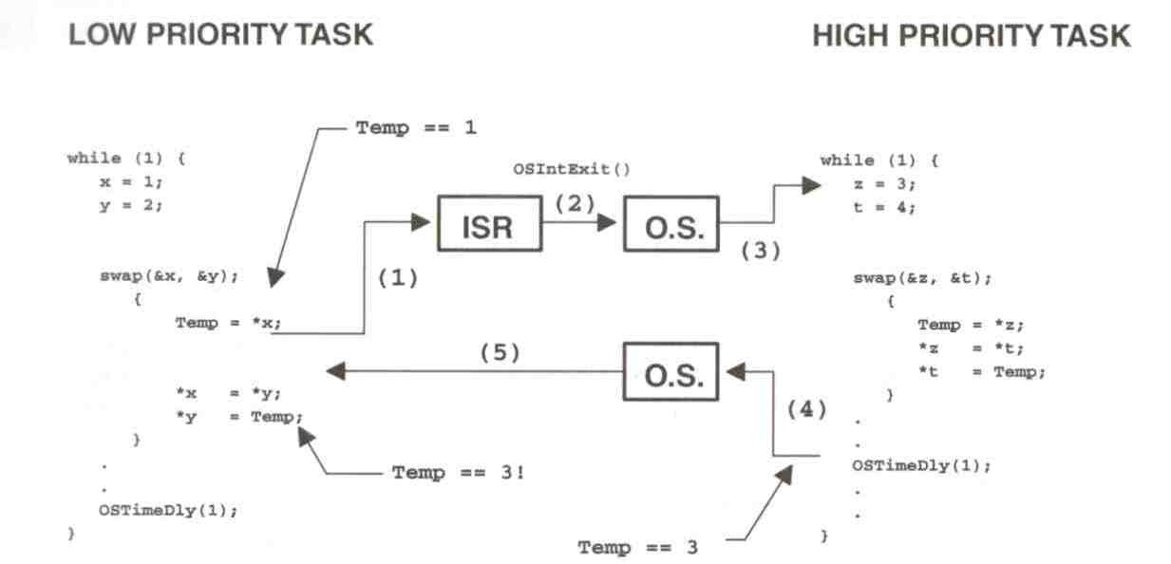
Non-Reentrant Function Example (cont.)

Slide 35
Resource Allocation in RTOS
Resource Allocation
  The issues with scheduling applicable here.
  Resources can be allocated in
    Weighted Round Robin
    Priority Based
Some resources are non preemptible
  Example: semaphores
Priority inversion problem may occur if priority scheduling is used

Slide 36
Priority Inversion Problem
Common in real-time kernels
Suppose task 1 has a higher priority than task 2
Also, task 2 has a higher priority than task 3
If mutual exclusion is used in accessing a shared resource, priority inversion may occur

Slide 37
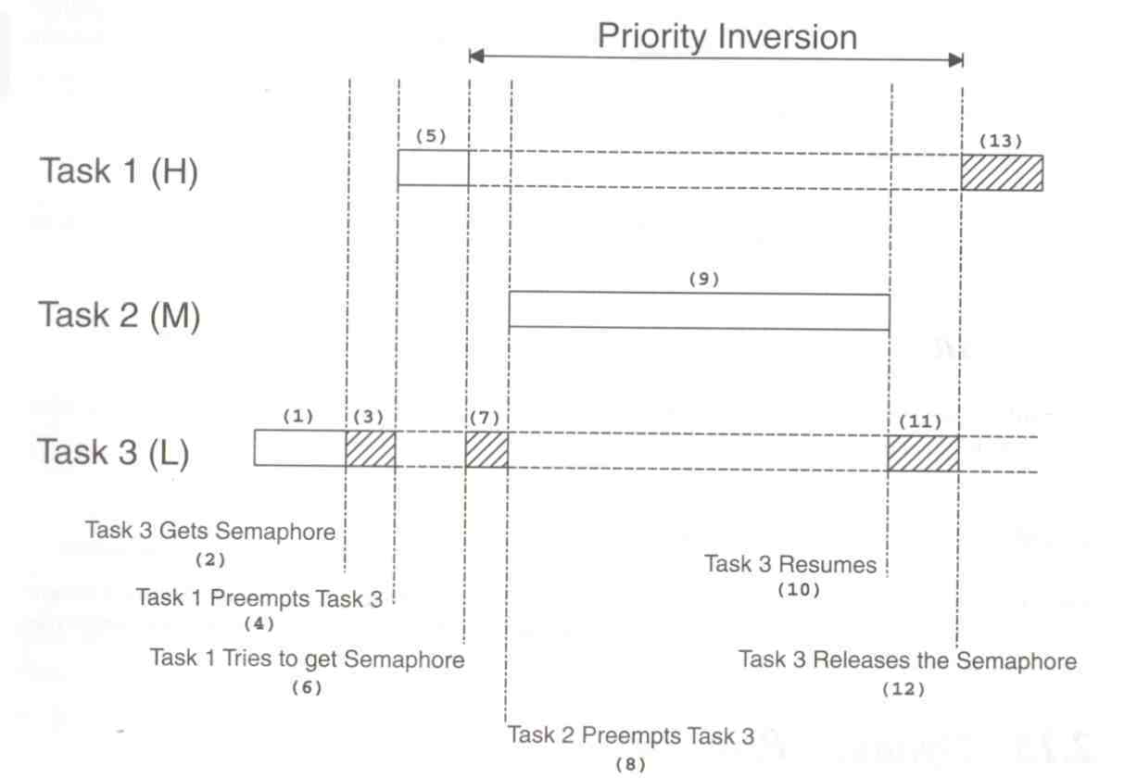
Priority Inversion Example

Slide 38
A Solution to Priority Inversion Problem
We can correct the problem by raising the priority of task 3
  Just for the time it accesses the shared resource
  After that, return to the original priority
  What if task 3 finishes the access before being preempted by task 1?
    incur overhead for nothing

Slide 39
A Better Solution to the Problem
Priority Inheritance
  Automatically change the task priority when needed
  The task that holds the resource will inherit the priority of the task that waits for that resource until it releases the resource

Slide 40
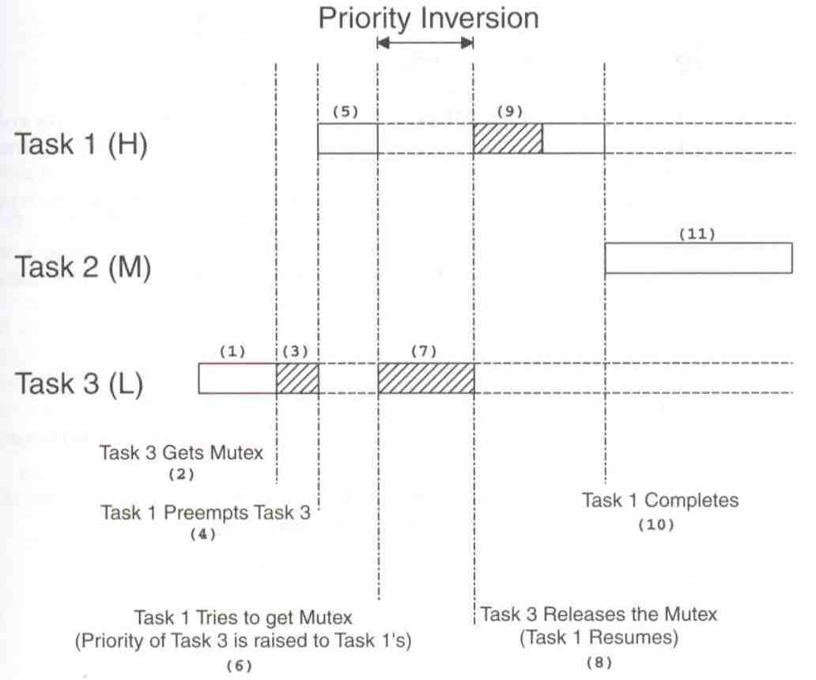
Priority Inheritance Example

Slide 41
Assigning Task Priorities
Not trivial
In most systems, not all tasks are critical
  Non-critical tasks are obviously low-priorities
Most real-time systems have a combination of soft and hard requirements

Slide 42
A Technique for Assigning Task Priorities
Rate Monotonic Scheduling (RMS)
  Priorities are based on how often tasks execute
Assumption in RMS
  All tasks are periodic with regular intervals
  Tasks do not synchronize with one another, share data, or exchange data
  Preemptive scheduling

Slide 43
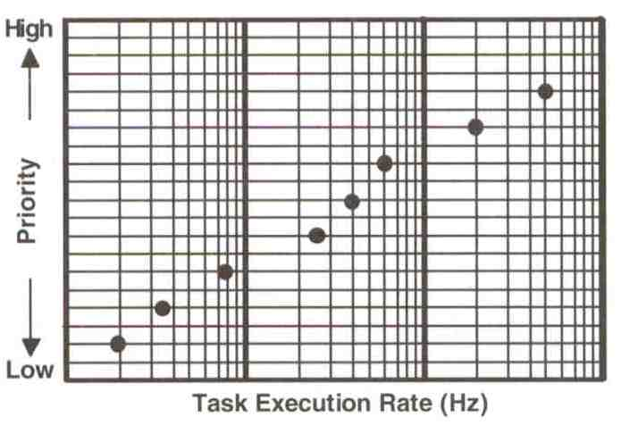
RMS Example

Slide 44
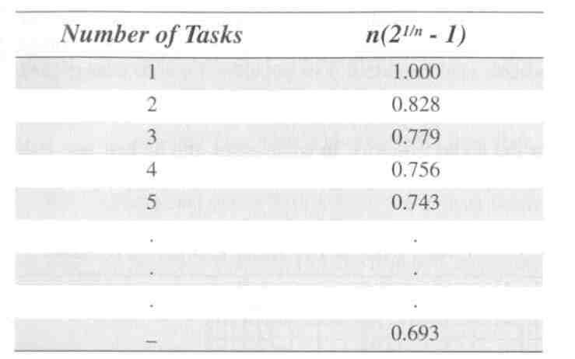
RMS: CPU Time and Number of Tasks

Slide 45
RMS: CPU Time and Number of Tasks (cont.)
The upper bound for an infinite number of tasks is 0.6973
  To meet all hard real-time deadlines based on RMS, CPU use of all time-critical tasks should be less than 70%
  Note that you can still have non-time-critical tasks in a system
  So, 100% of CPU time is used
  But not desirable because it does not allow code changes or added features later

Slide 46
RMS: CPU Time and Number of Tasks (cont.)
Note that, in some cases, the highest-rate task might not be the most important task
  Eventually, application dictates the priorities
  However, RMS is a starting point

Slide 47
Other RTOS issues
Interrupt Latency should be very small
  Kernel has to respond to real time events
  Interrupts should be disabled for minimum possible time
For embedded applications Kernel Size should be small
  Should fit in ROM
Sophisticated features can be removed
  No Virtual Memory
  No Protection

Slide 48
Mutual Exclusion
The easiest way for tasks to communicate is through shared data structures
  Global variables, pointers, buffers, linked lists, and ring buffers
Must ensure that each task has exclusive access to the data to avoid data corruption

Slide 49
Mutual Exclusion (cont.)
The most common methods are:
  Disabling interrupts
  Performing test-and-set operations
  Disabling scheduling
  Using semaphores

Slide 50
Disabling and Enabling Interrupts
The easiest and fastest way to gain exclusive access
Example:
Disable interrupts;
Access the resource;
Enable interrupts;

Slide 51
Disabling and Enabling Interrupts (cont.)
This is the only way that a task can share variables with an ISR
However, do not disable interrupts for too long
Because it adversely impacts the “interrupt latency”!
Good kernel vendors should provide the information about how long their kernels will disable interrupts

Slide 52
Test-and-Set (TAS) Operations
Two functions could agree to access a resource based on a global variable value
If the variable is 0, the function has the access
  To prevent the other from accessing the resource, the function sets the variable to 1
TAS operations must be performed indivisibly by the CPU (e.g., 68000 family)
Otherwise, you must disable the interrupts when doing TAS on the variable

Slide 53
TAS Example
Disable interrupts;
if (variable is 0) {
Set variable to 1;
Enable interrupts;
Access the resource;
Disable interrupts;
Set variable to 0;
Enable interrupts;
} else {
Enable interrupts;
}

Slide 54
Disabling and Enabling the Scheduler
Viable for sharing variables among tasks but not with an ISR
Scheduler is locked but interrupts are still enabled
  Thus, ISR returns to the interrupted task
  Similar to a non-preemptive kernel (at least, while the scheduler is locked)

Slide 55
Disabling and Enabling the Scheduler (cont.)
Example:
  Lock scheduler;
  Access shared data;
  Unlock scheduler;
Even though this works well, you should avoid it because it defeats the purpose of having a kernel

Slide 56
Semaphores
Invented by Edgser Dijkstra in the mid-1960s
Offered by most multitasking kernels
Used for:
  Mutual exclusion
  Signaling the occurrence of an event
  Synchronizing activities among tasks

Slide 57
Semaphores (cont.)
A semaphore is a key that your code acquires in order to continue execution
If the key is already in use, the requesting task is suspended until the key is released
There are two types
  Binary semaphores
    0 or 1
  Counting semaphores
    >= 0

Slide 58
Semaphore Operations
Initialize (or create)
  Value must be provided
  Waiting list is initially empty
Wait (or pend)
  Used for acquiring the semaphore
  If the semaphore is available (the semaphore value is positive), the value is decremented, and the task is not blocked
  Otherwise, the task is blocked and placed in the waiting list
  Most kernels allow you to specify a timeout
  If the timeout occurs, the task will be unblocked and an error code will be returned to the task

Slide 59
Semaphore Operations (cont.)
Signal (or post)
  Used for releasing the semaphore
  If no task is waiting, the semaphore value is incremented
  Otherwise, make one of the waiting tasks ready to run but the value is not incremented
  Which waiting task to receive the key?
    Highest-priority waiting task
    First waiting task

Slide 60
Semaphore Example
Semaphore *s;
Time timeout;
INT8U error_code;
timeout = 0;
Wait(s, timeout, &error_code);
Access shared data;
Signal(s);

Slide 61
Applications of Binary Semaphores
Suppose task 1 prints “I am Task 1!”
Task 2 prints “I am Task 2!”
If they were allowed to print at the same time, it could result in:
I Ia amm T Tasask k1!2!
Solution:
  Binary semaphore

Slide 62
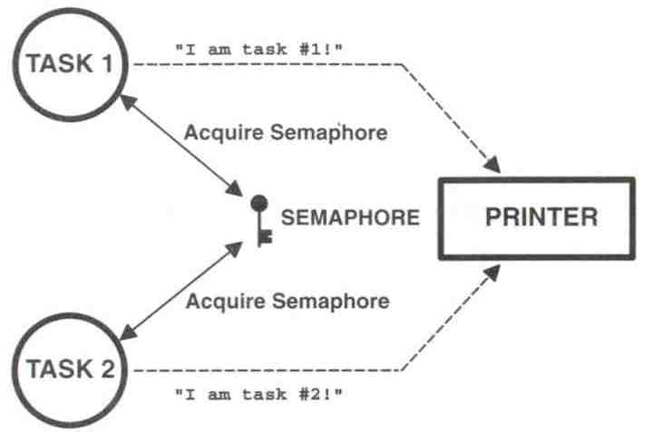
Sharing I/O Devices

Slide 63
Sharing I/O Device (cont.)
In the example, each task must know about the semaphore in order to access the device
A better solution:
  Encapsulate the semaphore

Slide 64
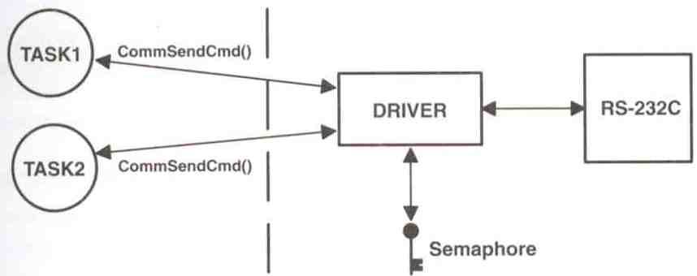
Encapsulating a Semaphore

Slide 65
Encapsulating a Semaphore (cont.)
INT8U CommSendCmd(char *cmd, char *response, INT16U timeout)
{
Acquire semaphore;
Send command to device;
Wait for response with timeout;
if (timed out) {
Release semaphore;
return error code;
} else {
Release semaphore;
return no error;
}
}

Slide 66
Applications of Counting Semaphores
A counting semaphore is used when a resource can be used by more than one task at the same time
Example:
  Managing a buffer pool of 10 buffers

Slide 67
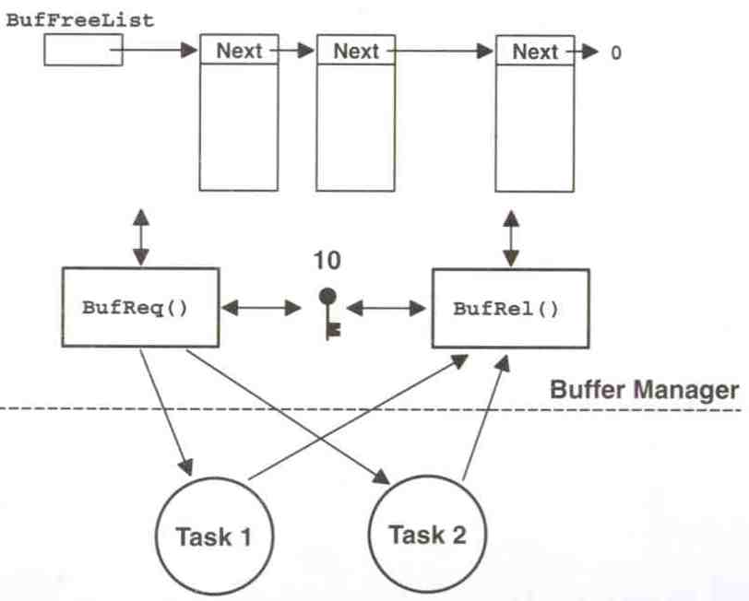
Buffer Management

Slide 68
Buffer Management (cont.)
BUF *BufReq(void)
{
BUF *ptr;
Acquire a semaphore;
Disable interrupts;
ptr = BufFreeList;
BufFreeList = ptr->BufNext;
Enable interrupts;
return (ptr);
}

Slide 69
Buffer Management (cont.)
void BufRel(BUF *ptr)
{
Disable interrupts;
ptr->BufNext = BufFreeList;
BufFreeList = ptr;
Enable interrupts;
Release semaphore;
}

Slide 70
Buffer Management (cont.)
Semaphores are often overused
The use of semaphore to access simple shared variable is overkill in most situations
For this simple access, disabling interrupts are more cost-effective
However, if the variable is floating-point and CPU does not support floating-point in hardware, disabling interrupts should be avoided

Slide 71
Linux for Real Time Applications
Scheduling
  Priority Driven Approach
    Optimize average case response time
  Interactive Processes Given Highest Priority
    Aim to reduce response times of processes
  Real Time Processes
    Processes with high priority
    There was no notion of deadlines

Slide 72
Linux for Real Time Applications (cont.)
Resource Allocation
  There was no support for handling priority inversion
Since version 2.6.18, priority inheritance available in both kernel and user space mutexes for preventing priority inversion

Slide 73
Interrupt Handling in Linux
Interrupts were disabled in ISR/critical sections of the kernel
There was no worst case bound on interrupt latency avaliable
  eg: Disk Drivers might disable interrupt for few hundred milliseconds

Slide 74
Interrupt Handling in Linux (cont.)
Linux was not suitable for Real Time Applications
  Interrupts may be missed
Since 2.6.18, Hard IRQs executed in kernel thread context
  (where differing priority levels can be assigned)
  allows developers to better insulate systems from external events

Slide 75
Other Problems with Linux
Processes were not preemtible in Kernel Mode
  System calls like fork take a lot of time
  High priority thread might wait for a low priority thread to complete it’s system call
Processes are heavy weight
  Context switch takes several hundred microseconds
Linux 2.6.18 adds preemption points in kernel, with the goal of achieving microsecond-level latency;
  all but "kernel-critical" portions of kernel code become preemptible involuntarily at any time

Slide 76
Why Linux ?
Coexistence of Real Time Applications with non Real Time Ones
  Example http server
Device Driver Base
Stability

Slide 77
Why Linux? (cont.)
Several real-time features are now integrated into the main distribution of Linux
  Improved POSIX compliancy
    including Linux's first implementation of message queues and of priority inheritance,
    as well as an improved implementation of signals less apt to disregard multiple inputs
  Hard IRQs executed in thread context

Slide 78
Why Linux? (cont.)
  Three levels of real-time preemptibility in kernel, configurable at compile time (throughput or real-time predictability):
    Voluntary preemption
    Preemptible kernel (ms level)
    Full real-time preemption (microsecond level)
  Priority inheritance available in both kernel and user space mutexes

Slide 79
Why Linux? (cont.)
  High-resolution timers
    Added in 2.6.21, this allows the kernel to actually use the high-resolution timers built into most processors, enabling,
    For example, POSIX timers and nano_sleep calls to be "as accurate as hardware allows,"
    The kernel's entire time management gets to the level of microseconds

Slide 80
Why Linux? (cont.)
  Various kernel config options for monitoring real-time behavior of kernel:
    CONFIG_LATENCY_TRACE
      Track the full trace of maximum latency
    CONFIG_WAKEUP_TIMING
      Tracking of the maximum recorded time between
        waking up for a high-priority task, and
        executing on the CPU, shown in microseconds

